Slide 1



Welcome to
Governors State University!

Slide 2
Financing Your Education

Slide 3

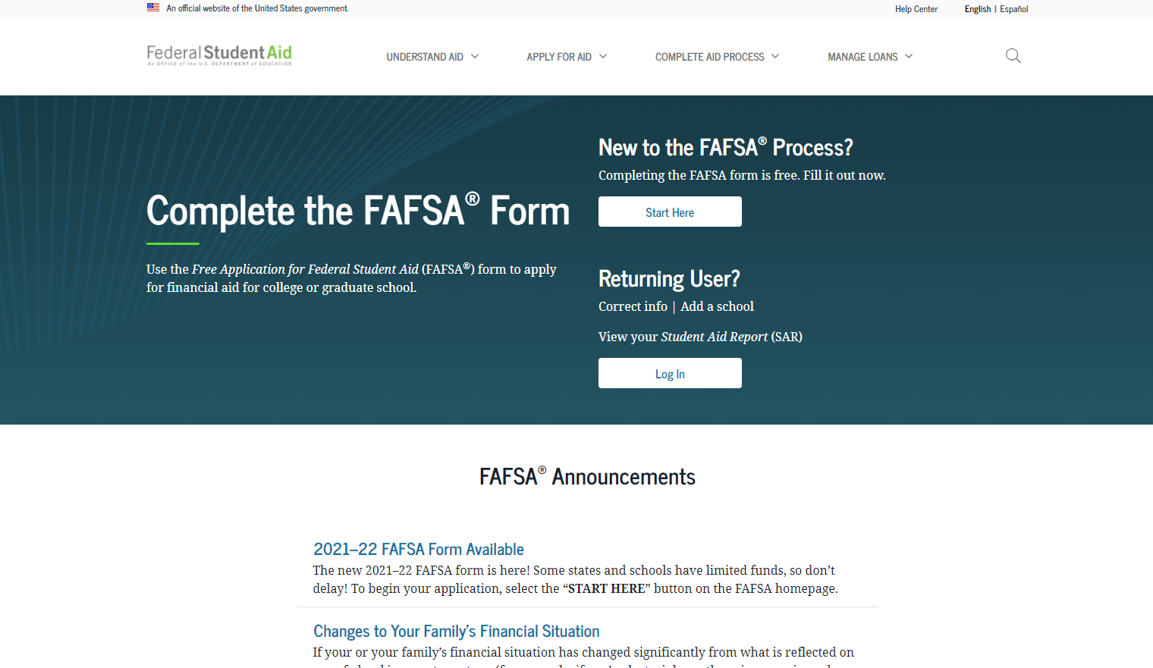
How Do I Apply for Financial Aid?
Have you done the #FAFSA?
Free Application for Federal Student Aid
Found online at studentaid.gov
Direct Link: (https://studentaid.gov/h/apply-for-aid/fafsa)

Slide 4

Types of Financial Aid
1. Grants
2. Loans
3. Scholarships
4. Student Employment Opportunities

Slide 5

Types of Grants
1. Federal PELL Grant
2. Illinois MAP Grant
3. Federal SEOG Grant
4. TEACH Grant

Slide 6

Student Loans
1. Federal Direct Loans*
-Subsidized
-Unsubsidized
-PLUS
2. Private Student Loans
*Students must be enrolled in at least half-time status with Financial Aid eligible coursework in order to be eligible for Federal loans.

Slide 7

Federal Work Study
https://www.govst.edu/work-study/
https://www.govst.edu/employment-resources/
-Employment on or off campus
-Minimum wage or higher
-Gain valuable work experience
-Search for available jobs on Jobs For Jaguars

Slide 8
AIM HIGH and Institutional Scholarships

Slide 9
AIM HIGH – First Year Students
GPA Threshold
Scholarship
HS GPA: 3.5 – 4.0 $5,000 annually
HS GPA: 3.0 – 3.49 $3,000 annually
Students must complete AIM HIGH Confirmation form as well as submit $50 enrollment deposit to secure scholarship.

Slide 10
AIM HIGH – Transfer Students
GPA Threshold | Scholarship
Transfer GPA: 3.5- 4.0 | $5,000 annually
Transfer GPA: 2.5-3.49 | $3,000 annually
Transfer Students must have earned a associates degree or be transferring from another 4 year university.
Must complete the confirmation form linked in award letter.

Slide 11
AIM HIGH Criteria
To qualify for AIM HIGH, students must:
Have attended an Illinois high school.
Be enrolled full time in a baccalaureate degree program at Governors State University for the first time.
Be a resident of Illinois.
Be a U.S. Citizen or eligible non-citizen.
Not have household income that exceeds eight times the poverty rate.
Meet full admissions criteria.
Not yet have earned a baccalaureate degree or 135 undergraduate credit hours.
Not be in default of student loans or owe a refund or repayment of state or federal grants or scholarships
Scholarship

Slide 12
AIM HIGH RETENTION
To remain qualified after the first year, you must:
Continuously enroll as a full-time student (at least 12 credit hours) at GSU for Fall and Spring semesters.
Maintain Financial Aid Satisfactory Academic Progress (SAP) as outlined by the SAP Policy.
Maintain a cumulative 2.5 institutional grade point average at GSU.
Submit the FAFSA or Alternative Application for Illinois Financial Aid each year you are enrolled at GovState.

Slide 13
Presidential, Provost and Deans Scholarships
For incoming Freshman entering Fall 2027
Students much apply and be admitted by November 15th
Qualifying students will be invited to apply.
Application is simple- student will be asked to fill out simple questions and a short essay.
Final students will be asked to come to campus and interview.
Decisions released in February.
Presidential- Full tuition and fees, plus housing plus a book scholarship
Provost- $8,000 for tuition and fees plus book scholarship
Deans- $7,000 for tuition and fees plus book scholarship

Slide 14
Scholarship Universe
GovState Scholarship homepage: www.govst.edu/Scholarships/
Scholarship Universe: www.govst.scholarshipuniverse.com/public
With Scholarship Universe, Students will be able to:
  • Answer questions and match to scholarship opportunities they are eligible for
  • Easily apply online to multiple scholarship opportunities through a personalized portal
  • See scholarship metrics to determine their chances and effort required to apply
  • Be alerted whenever they are matched to new scholarship opportunities
  • Receive automated reminders about outstanding tasks and next steps

Slide 15

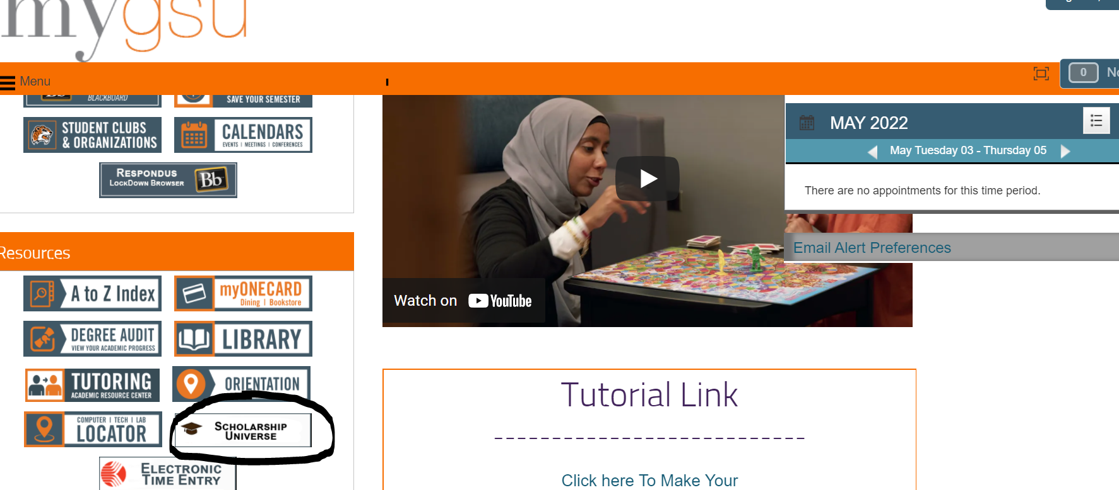
Starting Your Scholarship Search
You can start your scholarship search in your GovState Student Portal by accessing our scholarship database Scholarship Universe.

Slide 16
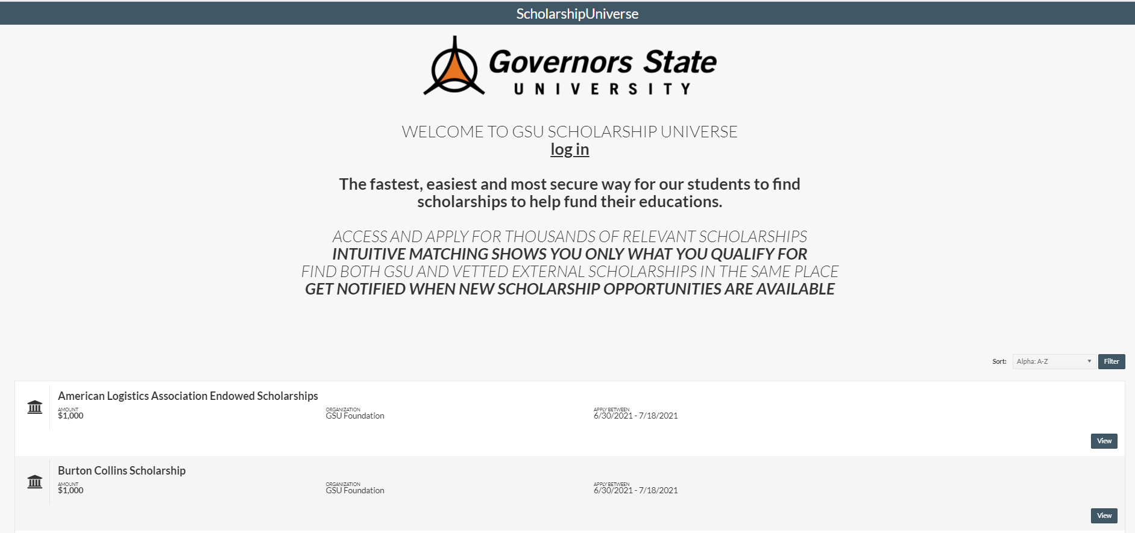
Scholarship Universe

Slide 17
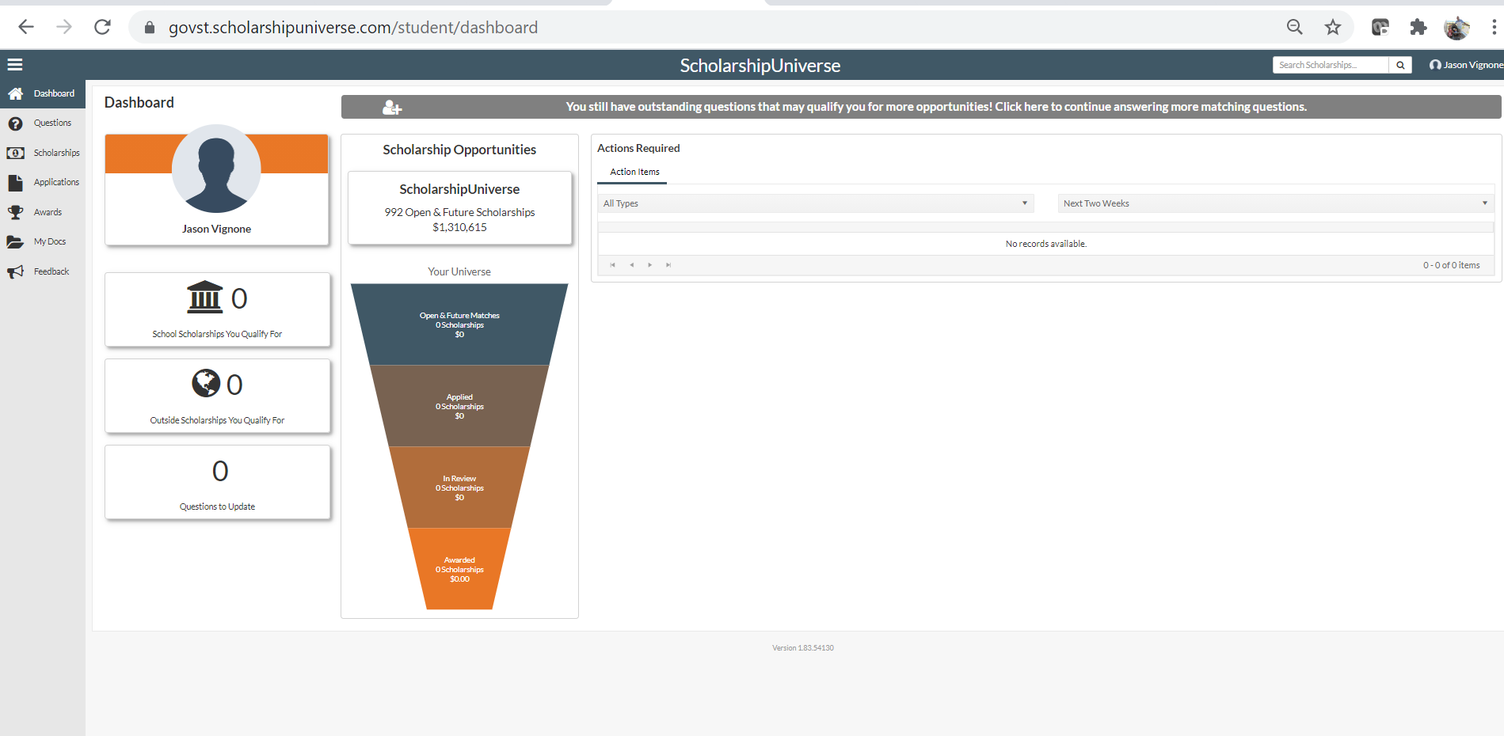
A Personalized Scholarship Experience

Slide 18
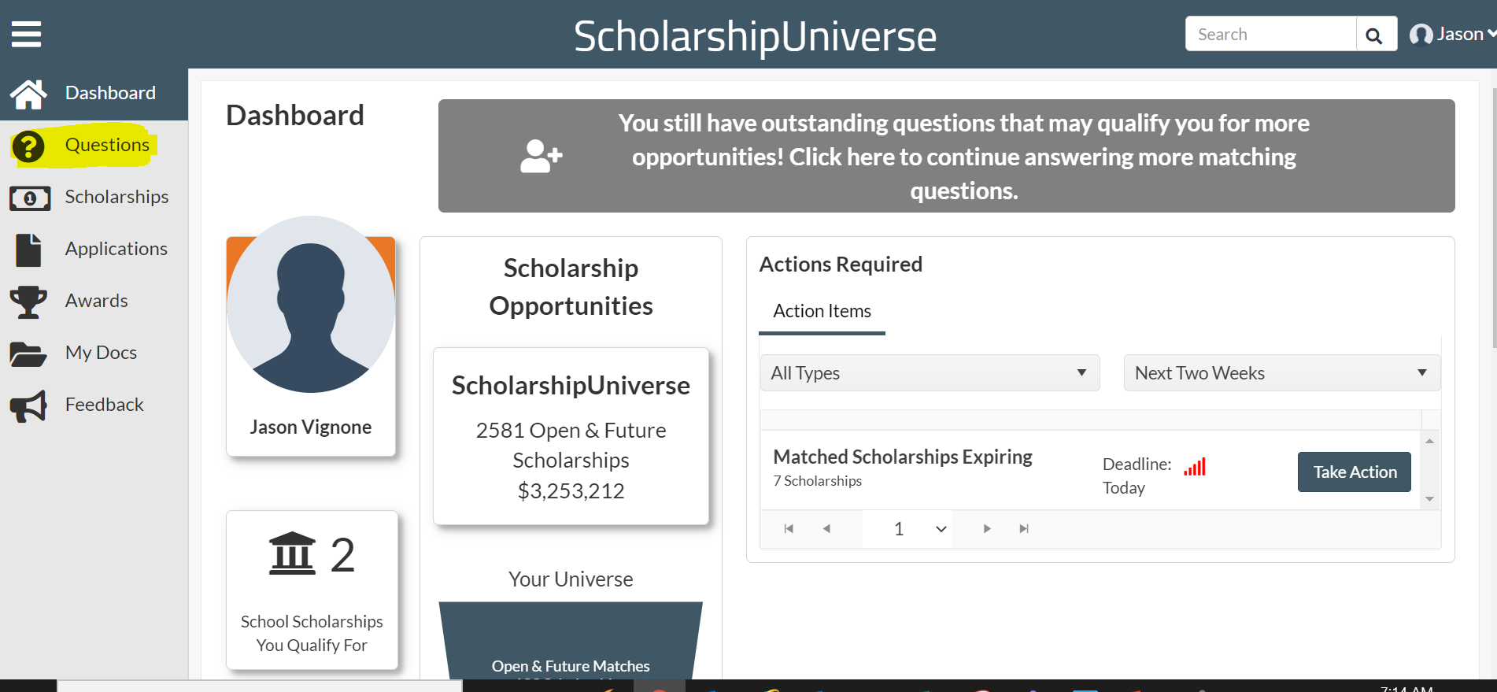
A Personalized Scholarship Experience
You can start your scholarship search in your GovState Student Portal by accessing our scholarship database Scholarship Universe. By answering questions about yourself you can tailor a search specific to you.

Slide 19

Office of Financial Aid
Contact us to schedule a one-on-one appointment! Office Hours 8:30am to 5pm Monday through Friday.
Phone: (708) 534-4480
Email: faid@govst.edu
Website: www.govst.edu/financialaid

